Slide 1

BSP Project on Pre-failure Alerting in BRM
Internship Based Project Presented to
Chhattisgarh Swami Vivekananda Technical University, Bhilai
Under the Guidance:
Mr. Abhinaw Jagtap
Assistant Professor, CSVTU, Bhilai(CG)
Presented By Madhurima Rawat B.Tech.(Hon) 6th Semester
Roll No. 300012821042
Enrollment No. CB4689
Notes:
Welcome to my presentation. I am currently interning at IIT Bhilai, where I am actively involved in a project. This presentation outlines the project itself, along with my contributions to it. Additionally, I will discuss the resources utilized and the skills acquired throughout this internship.

Slide 2
Contents
Introduction
Organization Overview
Internship Activities
Methodology
Implementation
Results and Discussion
Learning Outcome
Conclusion and Future Scope
References
Notes:
To facilitate seamless navigation, hyperlinks have been incorporated into each section. Simply click on the point to be directed to the corresponding section.

Slide 3
Introduction
Project Introduction And Significance Of The Topic

Slide 4
Introduction
Background Information:
Project on pre-failure alert generation for equipment at BSP's Bar and Rod Mill using data analytics.
Uses advanced data analytics to preempt failures and reduce operational disruptions.
Aims to preempt failures and reduce disruptions by analyzing equipment data patterns.
Project Objectives:
Conduct motif and discord analysis to identify normal patterns and anomalies.
Enhance the Grafana dashboard for improved data visualization.
Create visual tools and analyze case studies to refine anomaly detection.
Notes:
Manual data entry inefficiencies prompt automated BRM signal management, while format inconsistencies, storage limitations, and communication inefficiencies hinder BSP operations.

Slide 5
Introduction
Significance of the Project:
Improves equipment reliability and operational efficiency.
Predicts and prevents failures, leading to cost savings and productivity gains.
Represents a cutting-edge approach by integrating data analytics.
Scope and Limitations:
Scope: Analyze BSP mill server data, enhance Grafana dashboard, and validate anomaly detection.
Limitations: Irregular signal patterns and data vibrations/spikes complicate analysis.
Limitations: Potential for false positives in anomaly detection

Slide 6
Organization Overview
A Brief Overview About The Organization

Slide 7
Organization Overview
Institute Overview:
History: Established in 2016 by the Ministry of Education as one of six new IITs.
Size: Growing student body, expected to reach 12,000.
Location: Bhilai, Chhattisgarh, India.
Vision and Mission:
Vision: Significant role in national development through technological advancements.
Mission:
Provide a stimulating environment for learning and research in technology.
Foster innovation and originality.
Nurture well-rounded graduates equipped to address national challenges.

Slide 8
Organization Overview
Organizational Structure:
Governance: Managed by the Board of Governors (BOG) and the Senate, headed by the Director, supported by Deans and Heads of Departments.
Departments: Offers programs in Electrical Engineering, Computer Science, Mechanical Engineering, Physics, Chemistry, Mathematics, Liberal Arts, and Mechatronics.
Products and Services:
Educational Programs: Provides BTech, MTech, MSc, and PhD programs.
Research Activities: Focus on real-world applications and industrial collaborations.

Slide 9
Internship Activities
Internship: Activities, Skills, Challenges, Achievements, Learnings

Slide 10
Internship Activities and Skills
Description of Activities:
Facilitated data decoding from complex mill data into usable formats.
Conducted motif and discord analysis using advanced analytical techniques.
Enhanced data visualization dashboards for improved data exploration.
Skills Developed:
Strengthened data manipulation and visualization skills.
Expanded technical proficiency in using analytical tools and Python scripting.
Developed problem-solving abilities in optimizing data processing workflows.
Improved collaborative and communication skills through teamwork and project presentations.

Slide 11
Challenges and Learning
Challenges Faced
Overcame data decoding challenges to extract meaningful insights.
Addressed complexities in setting optimal thresholds for anomaly detection.
Managed challenges in integrating and automating features within Grafana dashboards.
Learning Outcomes
Acquired valuable insights into industrial processes and dynamics.
Enhanced practical knowledge applicable to real-world industrial settings.
Developed personal skills in time management and communication.

Slide 12
Methodology
Outlining The Approach Or Procedures Used In Project
Notes:
Here, in this section I have described the methodology that I have used in this project during my internship. I have also added skills that I learned.

Slide 13
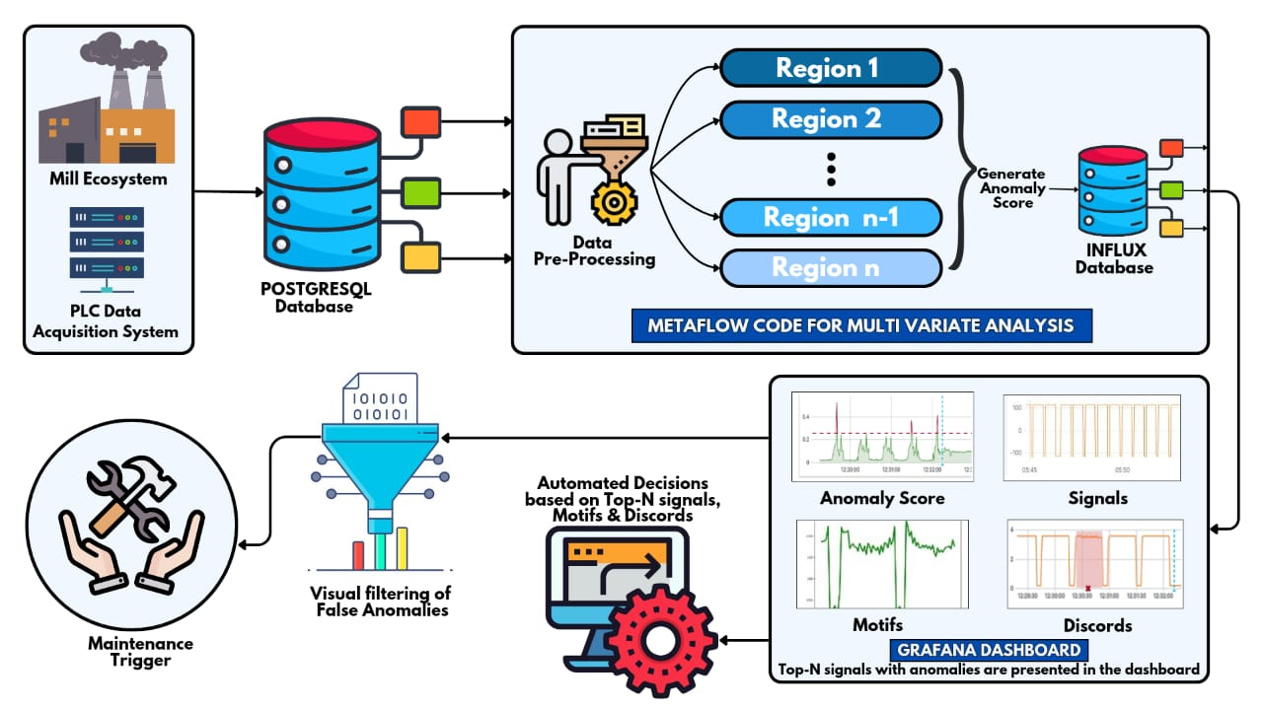
System Architecture
The internship project developed a system for identifying recurring patterns ("motifs") and deviations ("discords") within mill data.
Data from the mill was decoded for training and directly used from the server in deployment. It was preprocessed, stored in InfluxDB, visualized on a Grafana dashboard, and used to generate alerts for timely anomaly detection.
The objective was to enhance process optimization and anomaly detection capabilities.
Fig: System Architecture

Slide 14
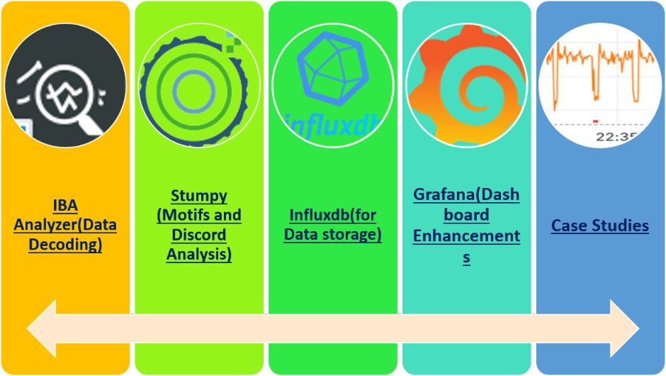
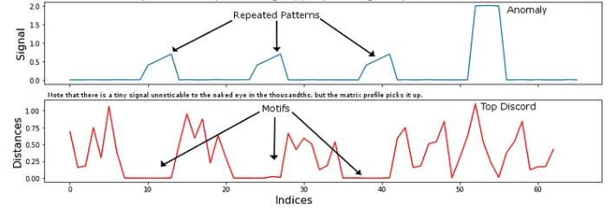
Methodology
Data Decoding: Transforming raw mill data from a complex, proprietary format (.dat) into a readily usable format for analysis using IBA Analyzer software.
Motif and Discord Analysis: Developing a system to identify recurring patterns ("motifs") and deviations ("discords") within the time series data.
Dashboard Enhancements: Creating informative and visually appealing Grafana dashboards to effectively communicate the identified motifs, discords, and other relevant data insights.
Fig: Methodology And Tools Used
Fig: Illustration of Motifs
Notes:
The resources used are diverse tools and platforms for thorough data analysis. IBA is employed for data decoding, while Stumpy is utilized for motif-discord analysis. Data visualization is executed to illustrate these motifs-discords effectively. InfluxDB serves as the database to store the data, and Grafana is utilized for the visualization of the analyzed data.

Slide 15
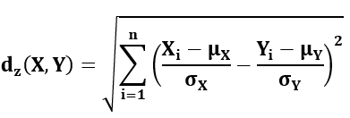
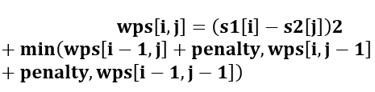
Motifs and Discords Detection
Motif Identification
Z-normalized Euclidean distance and matrix profile calculations were used to identify recurring patterns (“motifs”) within the time series data.
Discord Detection
Dynamic Time Warping (DTW) was employed to detect deviations ("discords") from the established motifs.

Slide 16
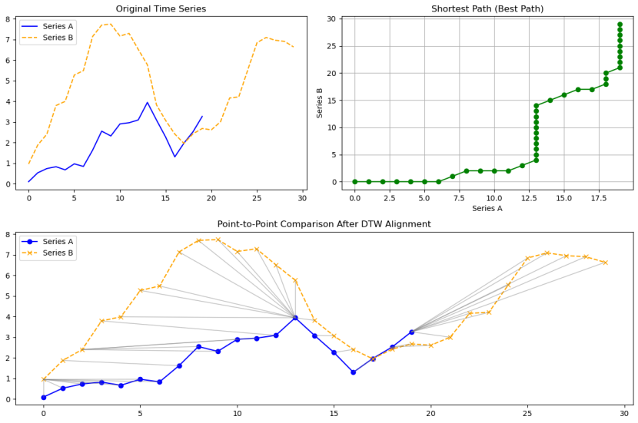
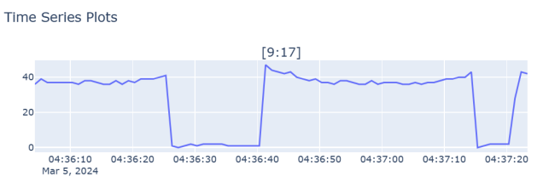
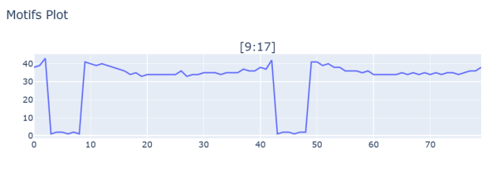
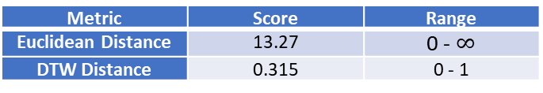
Euclidean vs DTW distance for Discords
Fig: Original and Motif Plot
Metric | Score | Range
Euclidean Distance | 13.27 | 0 - $∞$
DTW Distance | 0.315 | 0 - 1
Fig: Working of DTW Distance
Table: Results of Euclidean and DTW Distance
Euclidean distance may mistakenly flag more discords due to its sensitivity to outliers and variations, increasing false positives.
It fails when sequences have zero standard deviation, limiting its applicability in highly uniform data.
Z-Normalized Euclidean requires equal-length sequences, unlike DTW, which handles sequences of varying lengths flexibly.

Slide 17
Implementation
Details Of Project Planning And Execution

Slide 18
Motif Discovery and Window Size
Initial Motif Identification: Motifs (recurring patterns) were identified within the time series data for various sensors using techniques like stumpy's Matrix Profile algorithm.
Window Size Dependence: An important discovery was the dependence of identified motifs on the chosen window size (e.g., 40, 60, 80, 100 seconds). This analysis was performed for all sensors and window sizes.
Profile Dependence: A further layer of complexity was revealed as motifs were found to be dependent on the specific mill profile (BRM Mill profiles: 10mm, 12mm, 16mm, 20mm). Extensive analysis across various sensors was conducted to determine the optimal motif for each window size and profile combination.
True/False Positive Analysis: To identify the window size that captured the most variation aiding in anomaly detection, an analysis of true and false positives was conducted. This evaluation led to the conclusion that an 80-second window size yielded the most desirable results across all profiles.

Slide 19
Discord and Grafana Dashboard
Discord Detection and Distance Metric Selection
Distance Metric Exploration: Candidate distance metrics for discord (anomaly) detection were explored, including z-normalized Euclidean distance and Dynamic Time Warping (DTW) distance.
DTW Library Selection: Different libraries implementing DTW were evaluated for performance, with the focus on identifying the fastest option for real-time application.
Grafana Dashboard Development
Challenges were encountered in displaying motifs within the Grafana dashboard due to the dynamic range of the data.
This involved exploring various techniques to effectively represent the motifs as the range changed.

Slide 20
Results And Discussion
Presenting the Findings or Outcomes Obtained
Notes:
In this section, I have added the dashboard outputs from Grafana.

Slide 21
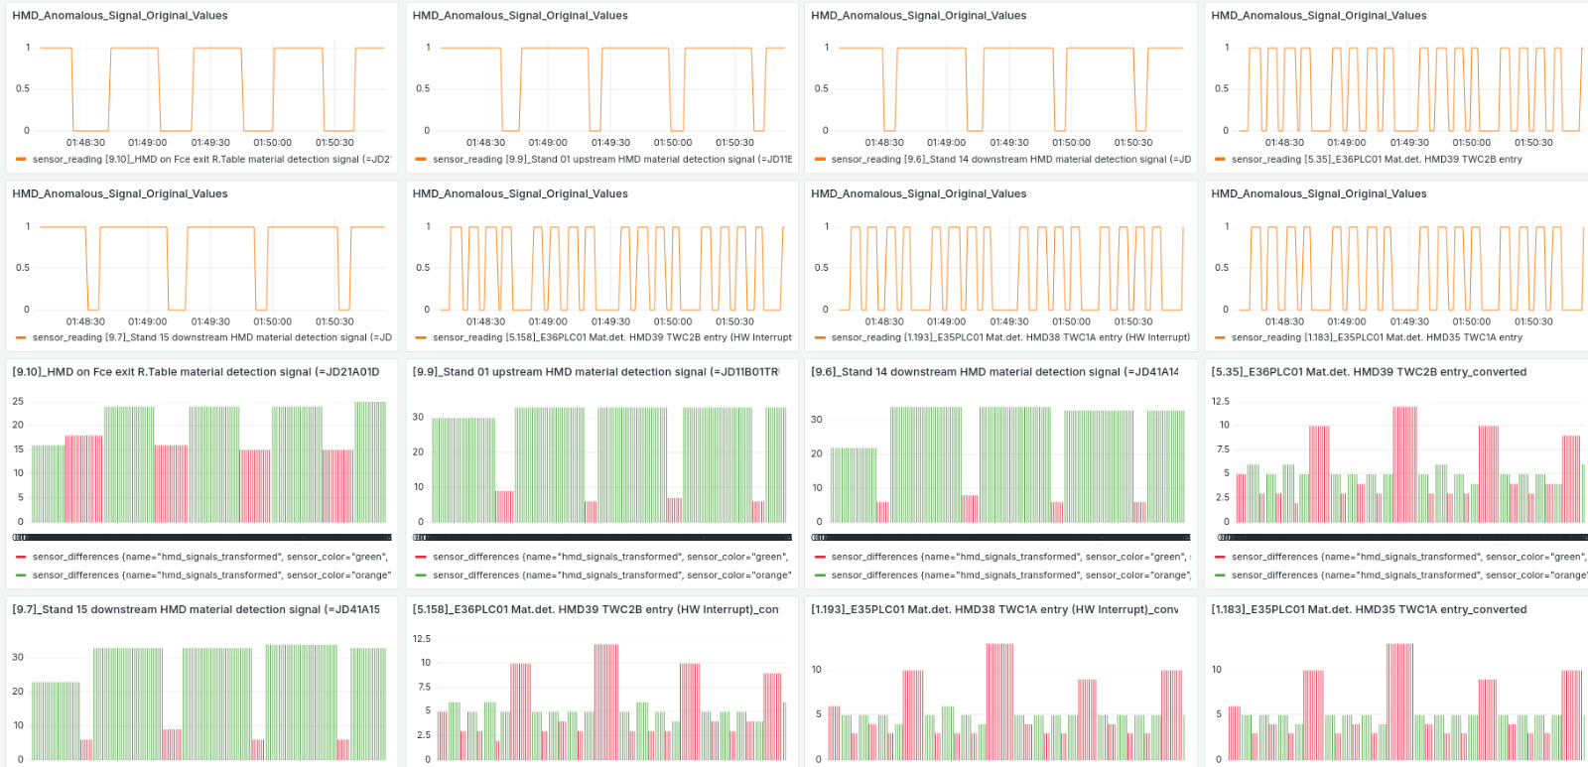
Binary Signals Visualization
Problem: Many signals are binary, where signal width is
crucial.
Solution: Convert original signals to bar charts for clear
width visualization.
Benefits:
Efficiency: Bar representation allows quick width
comparison.
Ease: Facilitates fast decision-
making.
Example:
Original Signals: Plot of original binary signals
Bar Chart: Displaying the corresponding bar chart for easy width comparison
Fig: Binary Signals Width Plotting

Slide 22
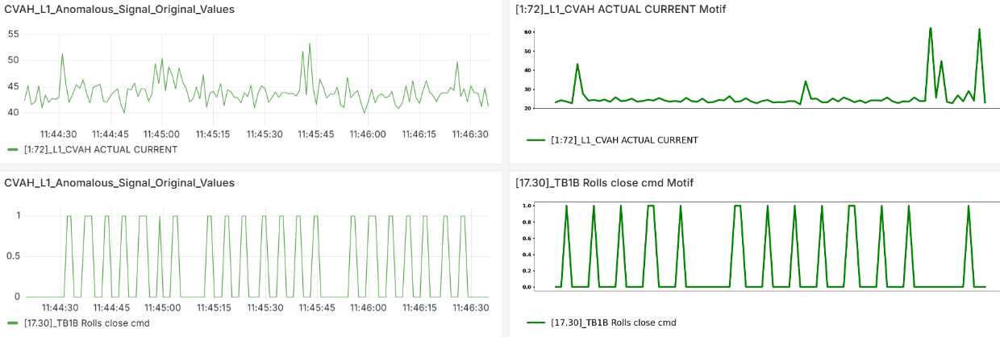
Motif Integration in Dashboard
Fig: Sensor Data and Motifs Images in Dashboard
The final step involved integrating these pre-generated motif images into the dashboard. By displaying the appropriate motif image alongside the corresponding sensor data, users can visually compare the actual signal behavior with the expected pattern represented by the motif.
Image Fetching and Display: Based on the extracted motif name, the associated image file (stored with descriptive names in profile folders) was retrieved. Finally, the retrieved motif image was displayed within the dashboard alongside the corresponding sensor data.

Slide 23
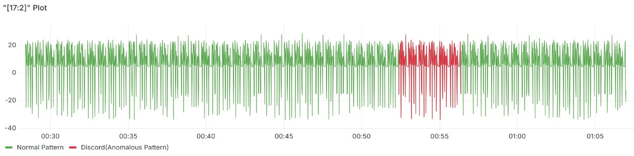
Discords Highlighting
Fig: Discords highlighting in Grafana Dashboard
Real-time Detection: Discords are identified as the data streams, ensuring continuous anomaly monitoring.
Flexibility and Customization: The Python script provides a versatile environment for implementing various anomaly detection algorithms, allowing for tailored solutions based on specific project requirements.
Enhanced Visualization: Anomalies are dynamically highlighted within the dashboard, enabling clear visual distinction between normal data and potential issues, facilitating rapid response and troubleshooting.

Slide 24
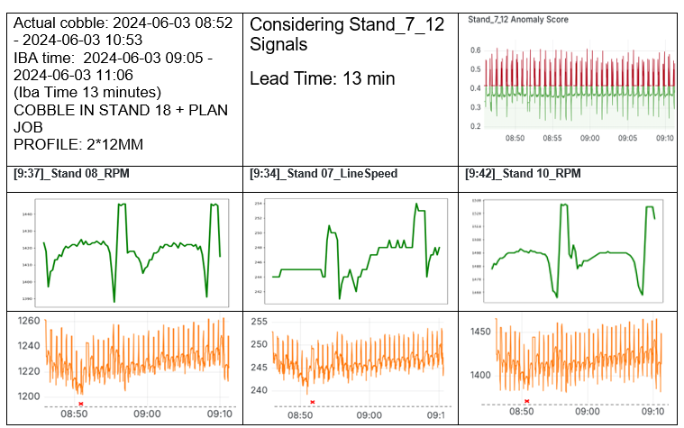
True Positive Case Study
COBBLE IN STAND 18
Monitoring: During the COBBLE IN STAND 18
(12MM profile), sensor [9:37]_Stand 08_RPM
maintained a consistent pattern until 08:50,
then dropped suddenly.
Pattern Observed: Similar drops were noted in
[9:34]_Stand 07_LineSpeed and [9:42]_Stand 10_RPM at around 08:50, followed by an increase.
Table: True Positive Case Study
Notes:
Here, I have outlined all the main results from this presentation.

Slide 25
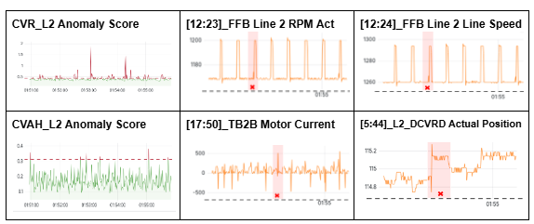
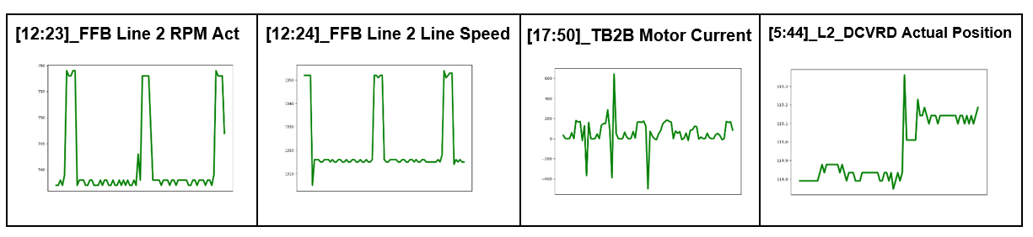
False Positive Case Study
COBBLE INDICATOR TIME: 2024-04-05 01:51:16
PROFILE - 2*12MM
False positives occur when the system incorrectly predicts a cobble, typically due to changing patterns such as a sudden decrease in sensor values or erratic fluctuations.
In this case study, a false positive was predicted in the CVAH_L1 and PINCHROLL_L2 region.
Table: False Positive Case Study
Fig: Motifs for the Sensors for Case Study

Slide 26
False Positive Case Study
In the CVAH_L1 region, anomalies detected at 2024-04-15 13:25:09 and earlier at 13:23:09 for signals [1:59]_E35_CVAH_Actual Torque and [1:33]_L1_PR4_ActTorque were consistent with normal patterns, indicating false positives for cobble events.
In the PINCHROLL_L2 region, deviations in signals [5:19]_L2_PR2_ActSpeed and [5:22]_L2_PR3_ActSpeed detected around 2024-04-15 13:19:58 and 13:23:09 were also within normal ranges, leading to the conclusion that the model's anomaly indications were false positives.
-Overall, the observed deviations in both regions were consistent with standard motifs and normal patterns, confirming that no actual cobble events occurred and the anomalies indicated by the model were false positives.

Slide 27
Learning Outcome
Learnings From The Project And Internship

Slide 28
Learning Outcome
Technical Skills Development: Gained proficiency in data visualization with tools like Grafana, advanced Python scripting for anomaly detection, and foundational skills in essential tools such as Microsoft Office
Problem-Solving Enhancement: Tackled project challenges with creative and systematic approaches, developing a robust problem-solving framework that involves breaking down complex issues, researching methodologies, testing different approaches, and iterating solutions for optimal outcomes.
Communication and Collaboration: Improved ability to articulate technical concepts clearly to diverse audiences and fostered active listening and teamwork, contributing to smoother project progress and collaborative success.
Professional Development: The internship solidified a passion for Data Science, highlighted strengths and areas for improvement, clarified career goals, and emphasized the importance of continuous learning.
Future Applications: Equipped with technical skills in data visualization and anomaly detection, problem-solving approaches, and communication abilities, prepared for academic research and future career opportunities.

Slide 29
Conclusion And Future Scope
Recap and Future Directions
Notes:
Summary for the presentation and future directions is added here.

Slide 30
Conclusion And Future Scope
Enhanced data visualization with bar charts for binary signals and motif-based anomaly detection, improving interpretability and issue identification.
Developed a Python script for real-time discord detection, enabling faster anomaly identification and clear visual representation in the Grafana dashboard.
Streamlined configuration management with an automated Python script, reducing time and errors during Grafana dashboard setup.
Achieved project objectives of improved data visualization, enhanced anomaly detection, and streamlined workflow, despite challenges with anomaly detection algorithms and visualization techniques.
Recommended future developments include advanced anomaly detection techniques, integration of machine learning models, and user interface refinements, alongside personal growth in technical expertise, problem-solving, and collaboration.
Notes:
Implications: Enhanced anomaly detection reduces false positives, informing proactive decision-making. Future directions include automation, threshold-based filtering, and real-time monitoring for improved system efficiency.

Slide 31
References
List of References Used
Notes:
In this section all references used in this project are added.

Slide 32
References
DTAIDistance Developers. (n.d.). https://dtaidistance.readthedocs.io/en/latest/modules/dtw.html
Grafana Labs. (n.d.). Grafana Documentation. https://grafana.com/docs
InfluxData, Inc. (n.d.). InfluxDB Documentation. https://docs.influxdata.com/influxdb/latest/
Mueen, A., Keogh, E., & Batista, G. (2006, December). Finding Temporal Motifs in Time Series Data. In Proceedings of the Sixth IEEE International Conference on Data Mining (ICDM'06) (pp. 796-801). https://www.cs.ucr.edu/~eamonn/Motif_Discovery_ICDM.pdf
Stumpy Documentation. (n.d.). https://stumpy.readthedocs.io/en/latest/Tutorial_STUMPY_Basics.html.
Notes:
Key resources utilized: IBA Analyzer for analysis, Stumpy for time series algorithms, InfluxDB for storage, and Grafana for visualization, supported by respective documentation and logos.

Slide 33

Thank You
Any Queries?
Notes:
Please feel free to ask any questions about the project or my contributions. If you have any concerns or need clarification, don't hesitate to reach out. Your feedback and inquiries are welcome.

